Slide 1

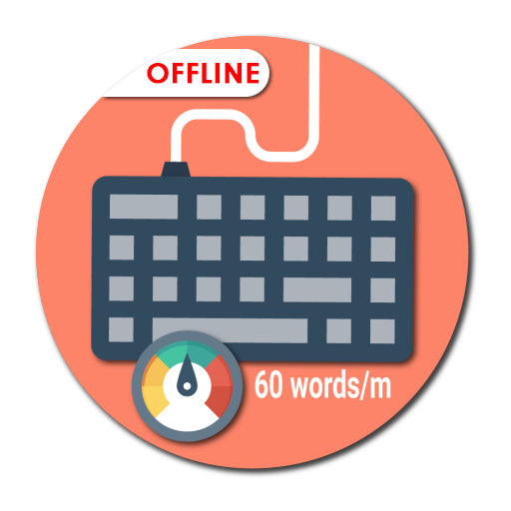
Kali Charan Nigam Institute of Technology,Banda
  Typing Speed Test
Presented by
Guided by
Pranjal Chakravarti
Roll no : 2101390100052
Mr. Jitendra Nishad
Bachelor of Technology
in
Computer Science & Engineering
Department of Computer Science & Engineering
Dec - 2022

Slide 2
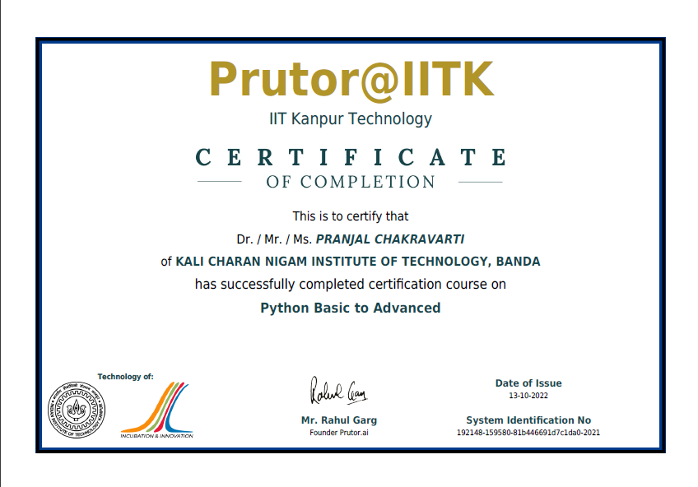

Slide 3
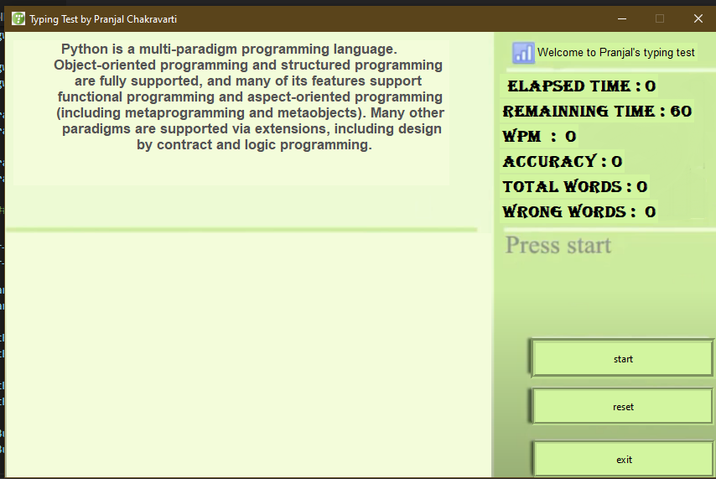
  1. Introduction
You can check and even improve your typing speed.
We use the Tkinter library
Working with graphics user interface draw the images and text
OUTPUT
Typing Speed Test
Dec - 2022
3

Slide 4
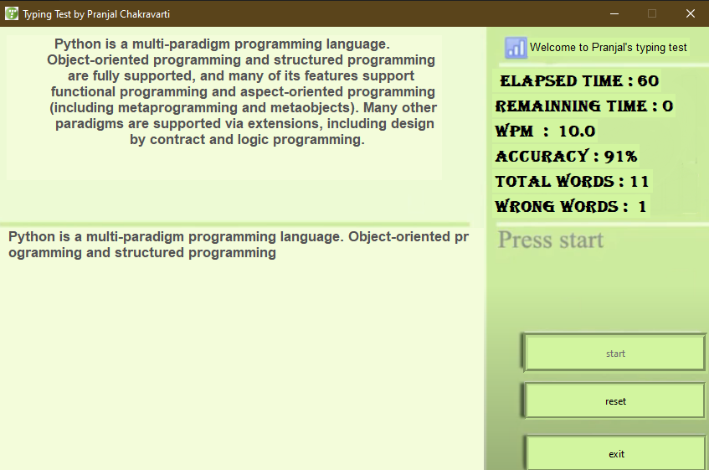
  2. Requirements
OUTPUT
SOFTWARE REQUIREMENT :
Operating System: - WINDOWS
Back End: - Python 3.9.5 Interpreter
Front End Language: - Python3
Front Design: - Tkinterface
HARDWARE REQUIREMENT :
Minimum RAM: - 1GB
Minimum Hard Disk: - 128GB
Processor: - Intel Pentium 4(2.0 GHz) or above
Typing Speed Test
Dec - 2022
4

Slide 5
  3. Data Flow Diagram
User
Typing Speed Test
Administrator
Typing Speed Test
7 Dec - 2022

Slide 6
  4.Modules
Elapsed Time
Remaining Time
WPM
Accuracy
Total words
Wrong words

Slide 7






  5. Applications
  Data Entry Blog Writer Coder
  Social Media Management Transcriptionist Journalism
Typing Speed Test
Dec - 2022
7

Slide 8
  6. Conclusion
Typing remains a fundamental skill
Most important computer skills
Learning to type fast and accurately
Typing faster is a simple way
Typing Speed Test
Dec - 2022
8

Slide 9

  8. Any Query
Typing Speed Test
Dec - 2022
9

Slide 10


